Slide 1
Anti-dilution Protection
Full Ratchet & Weighted Average plus “Exotics”
December 7, 2021
Scott Peterman, CFA
Partner, Hong Kong
K&L Gates
Scott.Peterman@klgates.com

Slide 2
A typical “startup” conversation https://startupfundingbook.com/dilution-splitting-equity-in-startups/ https://www.thefineryreport.com/articles/2021/1/29/how-to-startup-a-conversation-tech-and-operational
“Me: So, what did you guys think of the offer?
CEO: We’re gonna pass.
Me: Why? They are offering a valuation of 3X your last round only about 18 months ago.
CEO: Yeah, but their offer was too dilutive.”
On the one hand, the CEO is correct, but only because any issuance of additional stock is dilutive. If a company sold $1 million worth of stock at a $100 million pre-money valuation, that would be dilutive in the technical sense. Depending on the starting point, however, that might be a great deal.

Slide 4
Our topics for today
Background
Anti-dilution Protection – Type 1: Full Ratchet
Anti-dilution Protection – Type 2: Weighted Average
Review

Slide 5
Recap of basics
Percentage-based dilution vs. Share price dilution
Important things to keep in mind
Deals are negotiated with percentages, but structured with shares
Value of a company: known only when cash is exchanged for equity
Value of a company
total number of common shares X most recent share price
Pre-financing value + investment = post-financing value
Pre-financing value = post-financing value – investment
Price per share = amount of investment divided by # of shares

Slide 6
Introduction and Background
Anti-dilution provisions are designed to protect holders of convertible securities against dilution from a large variety of corporate events, including, among others stock dividends and splits, cheap issuances of additional common stock, and distributions of cash or property. Complex provisions that can have significant economic consequences are often given little systematic thought.
Even the most experienced practitioners often poorly understand how common anti-dilution provisions work. This lack of understanding is partially due to the complexity of these provisions, exacerbated by their mathematical nature, which is off-putting to many lawyers. And to entrepreneurs!
As a result, many practitioners mechanically rely on precedent without examining the consequences of using provisions that make sense in one context but not in another. Indeed, anti-dilution provisions are often rigorously examined only after they have been triggered, generally when an issuer is not succeeding and, as a consequence, tensions (and emotions) are heightened.

Slide 7
From a live deal . . . .

Slide 8
From a live deal . . . .

Slide 9
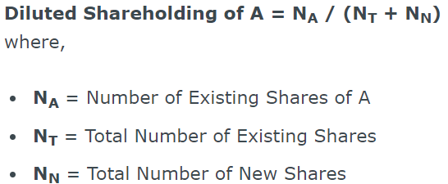
https://laptrinhx.com/dilution-formula-1153233244/

Slide 10
Private companies are not informationally efficient
Different types of anti-dilution provisions can generally be understood as a rational response to the nature and level of the information barriers and agency costs typically confronted in particular circumstances, and the existence or absence of other mechanisms to address these issues.
Information barriers exist at the time the investment in the convertible security is initially made, and increase the risk that the investor will overvalue the enterprise.
Agency costs are imposed at the time of the dilutive event, and the risk of incurring these costs exists whether the convertible securities are issued by public or private companies.
Anti-dilution protection is often the only logical way to protect against the risks presented by information barriers, but is one of many ways to minimize the risks of agency costs. Consequently, one would expect to see anti-dilution provisions used more uniformly to protect against risks from information barriers.

Slide 11
When convertible securities are used
Typically, convertible securities convert into a number of shares of common stock, calculated by dividing the initial purchase price (sometimes plus accrued but unpaid interest or dividends) by a fixed conversion price.
Actions taken by an issuer that increase the number (or decrease the value) of shares of its common stock outstanding will also decrease or “dilute” the value of the conversion right. It is conventional to include anti-dilution provisions in convertible securities to protect the value of the conversion right from certain of these actions.

Slide 12
Convertible securities are issued in a variety of contexts
Development-stage companies typically raise capital by issuing convertible preferred stock.
Intermediate-stage private companies (and small public companies with thin trading markets) often raise capital by issuing convertible securities in private placements to private equity funds and other institutional investors.
Widely traded public companies may raise capital by issuing convertible bonds or convertible preferred stock in public offerings or private placements in the belief that this will decrease their cost of capital.
In mergers and recapitalization, parties will sometimes receive convertible securities for a variety of economic, tax, accounting, and governance reasons.

Slide 13
Types of dilution
Dilution connotes a decrease in something. As applied to equity securities, there are two potentially relevant dilution concepts:
Percentage dilution, a decrease in the percentage of the entity an investor owns, and
Economic dilution, a decrease in the economic value of the investor’s investment in the entity.

Slide 14
Percentage dilution
In the absence of anti-dilution protection, percentage dilution will occur merely through the issuance of additional shares of common stock or securities convertible for common stock.
Example:
A owns 1000 common shares of X Corp. – 100% of the outstanding stock, worth $1000
X Corp. issues an additional 1000 common shares to B for $1000
A experiences percentage dilution of ownership from 100% (1000/1000) to 50% (1000/2000)

Slide 15
Percentage dilution
Percentage dilution has no direct relationship to the value of an investor’s holdings. All else being equal, if B pays X Corp. fair value for the stock issued, the current value of A’s holdings will not decrease.
As a result, investors typically do not use anti-dilution provisions to protect against percentage dilution, unless it is accompanied by economic dilution.
Example:
A owns 1000 common shares of X Corp. – 100% of the outstanding stock, worth $1000
X Corp. issues an additional 1000 common shares to B for $1000
Pre-investment by B, the value of A’s investment is $1000 (100% of a business worth $1000)
Post-investment by B, the value of A’s investment is $1000 (50% of a business worth $2000).

Slide 16
Economic dilution
Anti-dilution provisions are typically designed to protect against events that cause economic dilution, dilution that occurs as a result of a decrease in the value of the investment.
Example:
A paid $1 per common share for 1000 common shares of X Corp.
B buys 1000 common shares of X Corp. for $0.75 per share
A experiences both percentage dilution (from 100% to 50%) and economic dilution (A’s investment, initially worth $1000, decreases to $750 in value (1000 common shares now worth $0.75 per share)).
Conversely, if B pays $2 per share, A experiences percentage dilution (from 100% to 50%), but economic accretion. (A’s investment, initially worth $1000, increases to $2000 in value (1000 common shares now worth $2 per shares)).

Slide 17
Where to start? What to value?
To measure a decrease in value, one has to have a starting place. Thus, when considering economic dilution in any investment, distinguish between (i) dilution from initial investment (the value of the investment when originally made) and (ii) dilution from current value (the value of the investment immediately prior to the occurrence of the dilutive event).
Additionally, one must know exactly what is being valued. Thus, when analyzing economic dilution in connection with convertible securities, one can measure (i) dilution to the value of the convertible security itself (dilution to the full economic value) or (ii) dilution to the value of the securities receivable upon conversion (dilution to the immediate exercise value).

Slide 18
Initial investment vs. current value
“Initial investment” is the value of an investment when originally made. “Current value” is the value of an investment immediately prior to the occurrence of the dilutive event. An event may be dilutive to the initial investment, the current value, or both.
Notice that if X Corp. receives fair value in the issuance to B, any economic dilution from initial investment is not caused by the subsequent issuance. A’s stock has decreased in value, regardless of whether a new investment is made. B’s purchase merely evidences this decrease. This is an important observation that provides the rationale for one of the most controversial anti-dilution provisions, full-ratchet price protection, which is discussed in detail below.
Example:
A paid $1 per common share for 1000 common shares of X Corp.
B buys 1000 common shares for $0.75 per share at a time when the fair market value is $0.75 per common share.
A experiences economic dilution from A’s initial investment of $1000 (A’s investment is now worth $750), but no economic dilution from the current value of the investment of $750
Conversely, if B pays $1 per share when the fair market value was $3 per share, A experiences economic dilution from the current value, but no economic dilution from A’s initial investment.

Slide 19
Immediate exercise value versus full economic value
When analyzing economic dilution in connection with convertible securities, it is important to distinguish between
A decrease in the value of the convertible security itself (the “full economic value”) and
A decrease in the new value of the securities receivable upon conversion (the “immediate exercise value”).

Slide 20
“Dilution” in deal making
An investor in any given round of financing is concerned that the next round could be at a lower price per share than what he is paying this round. Therefore, the investor will insist upon anti-dilution protection.
If pressed for justification, the investor may explain that if the value of a company declines between rounds, management must be largely responsible.
The investor maintains that she shouldn’t be penalized for management’s deficiencies.

Slide 21
Background
Investors purchase preferred stock that is convertible into common stock.
Initially the conversion is on a one-to-one basis, or at the same share price as that paid for the preferred stock.
Anti-dilution Protection is implemented by adjusting the conversion price.
Two common types of Anti-dilution Protection:
Full Ratchet
Weighted Average

Slide 22
Anti-dilution Protection – Type 1: Full Ratchet

Slide 23
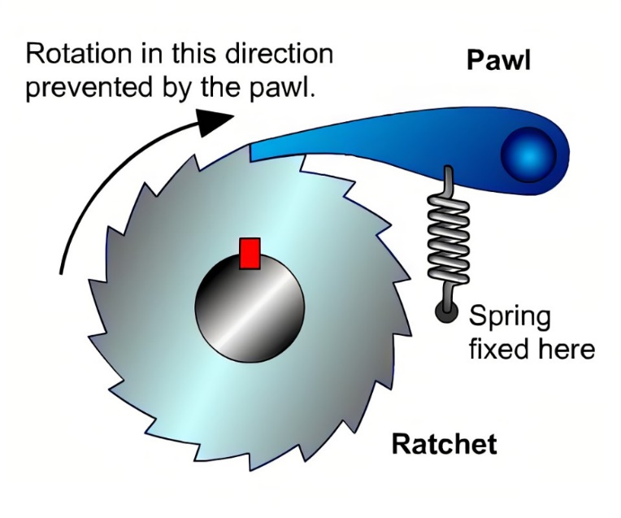
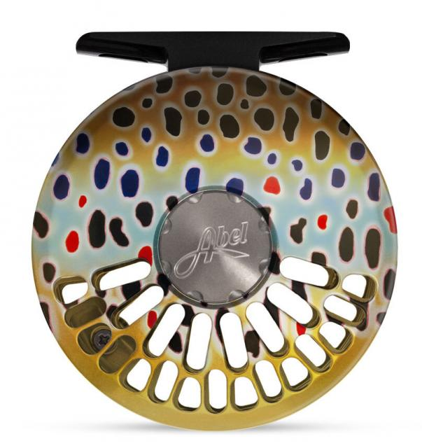
Background
Full Ratchet Anti-dilution Protection gives the original investor rights to that number of shares of common stock as if she paid the current round’s lower price.

Slide 24
Background
Language in a term sheet:
If the Company issues additional securities in the future at a purchase price less than the current Series A Preferred conversion price, the conversion price will be adjusted in accordance with the following formula:
Full-ratchet – the conversion price will be reduced to the price at which the new shares are issued.
National Venture Capital Association

Slide 25
The First Round
Example
I offer to invest $400,000 in your company in exchange for 40% of it.
Since you own all 600,000 shares of your company, I am offering to buy 400,000 new shares in order to acquire 40%.
My investment of $400,000 divided by 400,000 shares that I’m buying yields a per share price of $1.00.
Since you own 600,000 shares, that means the value of the stake in your company is $600,000, which is the pre-financing value.
Adding my $400,000 to that yields a post-financing value of $1,000,000.
That is confirmed by taking the total number of outstanding shares, 1,000,000 (your 600,000 and my 400,000) and multiplying that by the share price of $1.00.
That also says that the post-financing value of your company is $1,000,000.

Slide 26
The First Round

Slide 27
The Second Round
Without anti-dilution protection, the deal would proceed:
The new investor offers to invest $500,000 for 50% of your company.
If 50% of the company is worth $500,000, then the total company must be worth $1,000,000.
Since there are 1,000,000 shares outstanding today and they will represent 50% of the company after the financing, then the new investor is buying 1,000,000 shares.
The $500,000 investment divided by 1,000,000 shares yields a share price of $0.50.
National Venture Capital Association
Notes:
It’s time to raise some more money. Unfortunately, the only investment offer you are able to attract is at a lower price per share than the prior round.

Slide 28
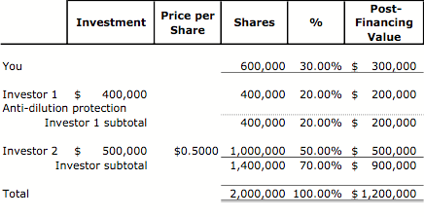
The Second Round
I paid $1.00 per share, the 400,000 shares that I paid $400,000 for are now worth $200,000 (400,000 shares X $0.50 per share).
The value of my investment has been diluted. From $1.00 to $0.50.
Worse, the percentage of the company I own has decreased (been diluted) from 40% to 20%.
By the same reasoning, founder’s equity stake is now worth only $300,000, and the Company only got $500,000 of investor’s money to keep the business alive.

Slide 29
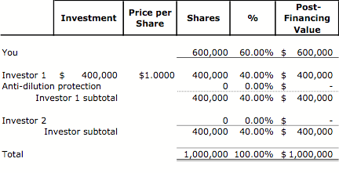
Without Anti-dilution Protection graphic: https://techcrunch.com/2019/06/04/dilution-the-good-the-bad-and-the-ugly
The First Round:
The Second Round:
Notes:
But I do have anti-dilution protection, so the deal will have needs to be adjusted.

Slide 30
The adjustment – Step 1
With anti-dilution protection, the deal would proceed:
The new investor offers to invest $500,000 for 50% of your company.
If 50% of the company is worth $500,000, then the total company must be worth $1,000,000.
Since there are 1,000,000 shares outstanding today and they will represent 50% of the company after the financing, then the new investor is buying 1,000,000 shares.
The $500,000 investment divided by 1,000,000 shares yields a share price of $0.50.
While I paid $1.00 per share, the new round will reduce that price to $0.50.
In addition to the original 400,000 shares for which I paid $400,000, I will receive an additional 400,000 shares, bringing my total shares to 800,000 ($400,000 divided by $0.50 per share).
Notes:
BUT I do have anti-dilution protection, so the deal will have needs to be adjusted.

Slide 31
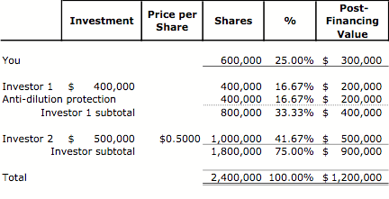
The adjustment – step 1
By issuing an additional 400,000 shares, the total number of shares has increased as well. The new investor would own only 42%. Should we stop here?
Notes:
Done? No.

Slide 32
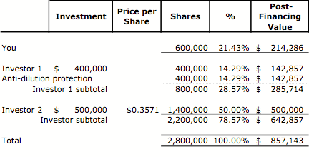
The adjustment – Step 2
Remember the first element of the deal:
The new investor offers to invest $500,000 for 50% of your company.
If 50% of the company is worth $500,000, then the total company must be worth $1,000,000.
Since there are 1,400,000 shares outstanding, including those created by my anti-dilution protection, the new investor must buy 1,400,000 shares to purchase 50%.
The $500,000 investment divided by 1,400,000 shares yields a share price of $0.36.
Notes:
Done? Nope.

Slide 33
The adjustment – Step 3
With the share price having dropped to $0.36, my anti-dilution protection needs to be recalculated
Since the price per share this round is $0.36, in addition to the original 400,000 shares for which I paid $400,000, I will receive an additional 720,000 shares, bringing my total shares to 1,120,000 ($400,000 divided by $0.36 per share).
Notes:
Done? Nope. Beginning to see a pattern.

Slide 34
The adjustment – Step 4
When I get additional shares from anti-dilution protection, the investor’s ownership drops to less than 50%.
The share price is reduced so that the investor is buying enough shares to own 50%.
The lower price means I get more shares. That lowers the investor’s share price. And on and on…
Image by Eric Drost
Notes:
This why I learned to use the “Iterate” function in my spreadsheet.

Slide 35
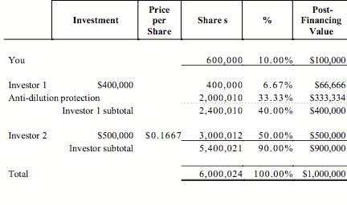
The Investor Outcome
The share price drops all the way to less than $0.17.
The new investor buys 3,000,012 shares.
I get 2,000,010 shares as a result of Full Ratchet anti-dilution protection.

Slide 36
Your Outcome
All of these adjustments have occurred to the investors’ positions.
What happens to you?
It isn’t pretty. As the number of shares for the investors ratchet higher and higher, your number of shares remains constant at 600,000.
Your share of your company has fallen to 10%!
The value of your shares has dropped to $100,000!
Notes:
As you may have noticed, all of these adjustments have occurred to the investors’ positions. What happens to you?
It isn’t pretty. As the number of shares for the investors ratchet higher and higher, your number of shares remains constant at 600,000.

Slide 37
Review
Deals are negotiated with percentages, but are structured with shares.
The value of a company is determined by multiplying the total number of common shares by the most recent share price.
Price per share = Amount of investment divided by the number of shares purchased.
An investor in any given round of financing is concerned that the next round could be at a lower price per share than what he is paying this round.
The investor will insist upon anti-dilution protection. Full Ratchet anti-dilution protection is very friendly to the investor and is very harsh to the founder.
Full Ratchet anti-dilution protection:
Investor
Founder
Notes:
As I’ve said before, these may appear to be pretty dry and boring gobblygook, but as we’ve seen, they can have very significant consequences.

Slide 38
Anti-dilution Protection – Type 2: Weighted Average

Slide 39
Background
Unlike Full Ratchet anti-dilution protection that is effectively a “do-over,” Weighted Average anti-dilution protection gives consideration to the relationship between the total shares outstanding as compared to the shares held by the original investor.

Slide 40
Background
Language in a term sheet:
If the Company issues additional securities at a purchase price less than the current Series A Preferred conversion price, the conversion price will be adjusted in accordance with the following formula:
CP₂ | = | CP1 * (A+B) / (A+C), where:
CP₂ | = | New Series A Conversion Price
CP₂ | = | Series A Conversion Price in effect immediately prior to new issue
A | = | Number of shares of Common Stock deemed to be outstanding immediately prior to new issue (includes all shares of outstanding common stock, all shares of outstanding preferred stock on an as-converted basis, and all outstanding options on an as-exercised basis; and does not include any convertible securities converting into this round of financing)
B | = | Aggregate consideration received by the Corporation with respect to the new issue divided by CP1
C | = | Number of shares of stock issued in the subject transaction

Slide 41
The First Round
Example
I offer to invest $400,000 in your company in exchange for 40% of it.
Since you own all 600,000 shares of your company, I am offering to buy 400,000 new shares in order to acquire 40%.
My investment of $400,000 divided by 400,000 shares that I’m buying yields a per share price of $1.00.
Since you own 600,000 shares, that means the value of the stake in your company is $600,000, which is the pre-financing value.
Adding my $400,000 to that yields a post-financing value of $1,000,000.
That is confirmed by taking the total number of outstanding shares, 1,000,000 (your 600,000 and my 400,000) and multiplying that by the share price of $1.00.
That also says that the post-financing value of your company is $1,000,000.

Slide 42
The First Round

Slide 43
The Second Round
Without anti-dilution protection, the deal would proceed:
The new investor offers to invest $500,000 for 50% of your company.
If 50% of the company is worth $500,000, then the total company must be worth $1,000,000.
Since there are 1,000,000 shares outstanding today and they will represent 50% of the company after the financing, then the new investor is buying 1,000,000 shares.
The $500,000 investment divided by 1,000,000 shares yields a share price of $0.50.
Since I paid $1.00 per share, I’m not happy. In fact, the 400,000 shares that I paid $400,000 for are now worth $200,000 (400,000 shares X $0.50 per share).
Notes:
It’s time to raise some more money. Unfortunately, the only investment offer you are able to attract is at a lower price per share than the prior round.

Slide 44
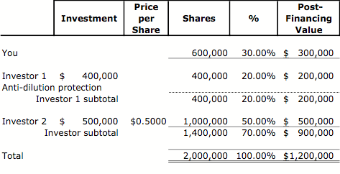
The Second Round
The value of my investment has been diluted.
In addition, the percent of the company I own has decreased (been diluted) from 40% to 20%.
By the same reasoning, your equity stake is now only worth $300,000, and you’ve only got $500,000 of investor’s money to keep your business alive.
BUT I do have anti-dilution protection, so the deal will have to be adjusted.

Slide 45
Without Anti-dilution Protection
The First Round:
The Second Round:

Slide 46
The Adjustment – Scenario 1
With anti-dilution protection, the deal would proceed:
The new investor offers to invest $500,000 for 50% of your company.
Let’s enter the values for the variables in the Weighted Average anti-dilution formula:
CP₂ | = | CP1 * (A+B) / (A+C), where:
CP₂ | = | New Series A Conversion Price
CP₁ | = | $1.00
A | = | 1,000,000
B | = | 500,000
C | = | 1,000,000
CP₂ | = | $1.00 * (1,000,000 + 500,000) / (1,000,000 + 1,000,000)
CP₂ | = | $1.00 * (1,500,000) / (2,000,000)
CP₂ | = | $0.75

Slide 47
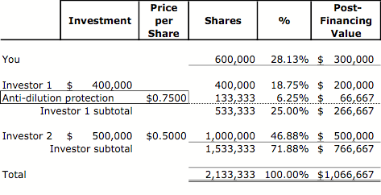
The Adjustment – Scenario 2
My conversion price being reduced from $1.00 to $0.75, my 400,000 shares of preferred stock will convert into 533,333 shares of common stock.
Weighted Average anti-dilution protection has given me the rights to 133,333 shares of common stock.
Deals are negotiated with percentages, but are structured with shares.
Notes:
Are we done? Maybe. Maybe not.

Slide 48
The Adjustment – Scenario 2
Remember the first element of the deal:
The new investor offers to invest $500,000 for 50% of your company.
Does that mean before, or after, consideration of the shares associated with the anti-dilution protection? If the former, then the solution found above is correct.
If the latter, then we have to put the “Iterate” function of our spreadsheet to work again.
This yields a transaction price per share of $0.4231, instead of $0.50.
My conversion price has become $0.6875, instead of $0.75 and the number of common stock shares to which I have rights has increased from 533,333 shares to 581,818 shares.
Notes:
Are we done? Maybe. Maybe not.

Slide 49
The Investor Outcome
The new investor buys 50% of the company (or almost 50%, depending upon the scenario that’s been selected).
I get rights to less than 200,000 shares of common stock as a result of Weighted Average anti-dilution protection. That’s something, but pretty modest when compared to the 2,000,010 shares that resulted from Full Ratchet anti-dilution protection.

Slide 50
Your Outcome
Just as in the case of full ratchet anti-dilution protection, all of these adjustments have occurred to the investors’ positions. What happens to you?
It isn’t pretty. As the number of shares for the investors ratchet higher and higher, your number of shares remains constant at 600,000.
Your share of your company is in the range of 25-30%, compared to 10% with Full Ratchet!
The value of your shares has dropped to less than $300,000, which is better than $100,000 in the Full Ratchet case! You have paid a price for the down round, but not to the extreme of Full Ratchet anti-dilution protection.
https://www.netsuite.com/portal/business-benchmark-brainyard/industries/articles/cfo-central/funding.shtml

Slide 51
Takeaways
An investor in any given round of financing is concerned that the next round could be at a lower price per share than what he is paying this round. Therefore, the investor will insist upon anti-dilution protection.
Weighted average anti-dilution protection is more friendly to entrepreneur than full ratchet anti-dilution protection since it takes the share base into consideration.
To Entrepreneur:
Full ratchet
Weighted Average
Notes:
As I’ve said before, these may appear to be pretty dry and boring gobblygook, but as we’ve seen, they can have very significant consequences.

Slide 52
Other protections
Liquidation or sale of the company
Alter any provision of the corporation that would be adverse to investors
Create any security senior to investor’s security
Borrow money greater than some amount

Slide 53
Remember the “golden rule”
Common theme: these features are expressed in terms of what investors “need” from company. In many cases, however, their primary purpose to provide protection from the next round investors. Do these protections really create “bargaining chips” to trade with follow-on investors?

Slide 54
Sources consulted
Michael A. Woronoff and Jonathan A. Rosen, Understanding Anti-Dilution Provisions in Convertible Securities, 74 Fordham L. Rev. 129 (2005). Available at: https://ir.lawnet.fordham.edu/flr/vol74/iss1/4
Frank Demmler, “On Venture Capital and Entrepreneurship”
“RaIsing Venture Capital,” by Rupert Pearce and Simon Barnes

Slide 55
Q&A

